Slide 1


Collaboration In Artificial Intelligence
Automation of MA-STRIPS problem
Gym – Model Problem
Instructor: Prof. Roni Stein
By: Gil Hatav, Netanel Prat

Slide 2
Introducing the problem:
The problem is about creating training programs for trainees that come to the gym.
We have couple of trainees that wants to train in the gym at specific time.
Each trainee has a training program he wants to achieve during the session.
In the gym there are standalone exercises and collaborative exercises.

Slide 3
The Goal:
Plan the shortest training program for trainees as a group

Slide 4

Formalizing the problem:
Trainees: $Agents=\left\{A_{i} \right|i∈[1,n]\}$
Collaborative Exercises : CE $\left\{\text{′}\text{Squat}\text{′}\text{, }\text{′}\text{Deadlift}\text{′}\text{, }\text{′}\text{BenchPress}\text{′}\text{, }\text{′}\text{Arms}\text{_}\text{SeatedInclineDumbbellCurl}’ \right\}$
Standalone Exercises : SE $\left\{\text{′}\text{Lunges}\text{′}\text{, }\text{′}\text{PushPress}\text{′}\text{, }\text{′}\text{PushUps}\text{′}\text{, }\text{′}\text{PullUps}\text{′}\text{, }\text{′}\text{Back}\text{_}\text{TBarR}\text{′}\text{Back}\text{_}\text{30}\text{DegreeLatPulldown}’ \right\}$
Training Program: $TR=\left\{TR_{i} \right| i∈[1,n]\}$
Objective Function: MakeSpan

Slide 5
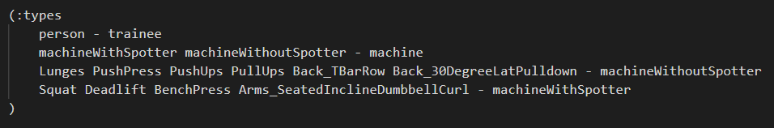
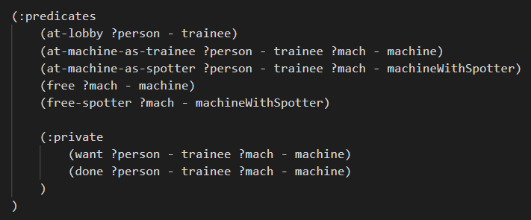
Types & Predicates

Slide 6
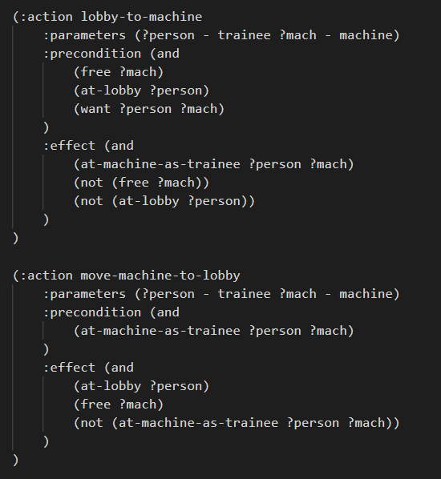
Actions

Slide 7
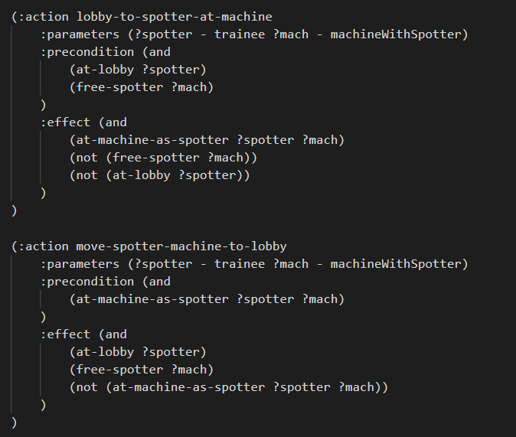
Actions

Slide 8
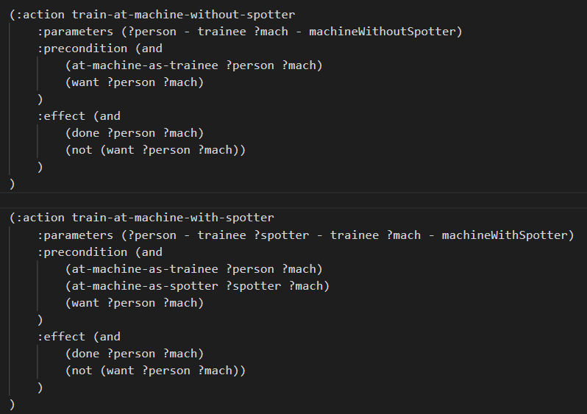
Actions

Slide 9
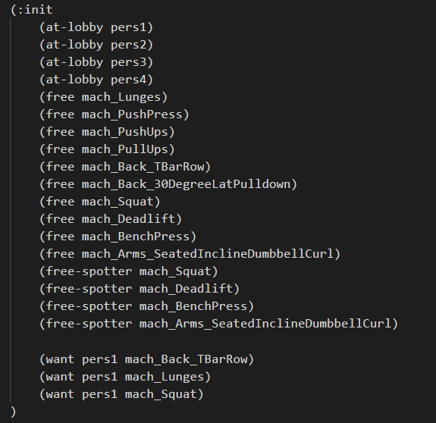
Init

Slide 10
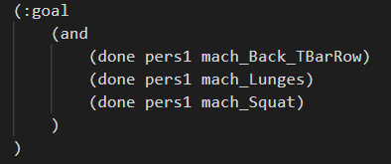
Goal

Slide 11
Our work:
We have created a generic generator for the gym – model problem .
We have created a generic template for the problem.
The generator generates the PDDL domain and problem files.
The generator has 2 modes:
Fully automation - according to given parameters (#agents, #min_CE, #max_CE, #min_SE, #max_SE).
Manual automation - creating by reading files.

Slide 12

Illustraion:

Slide 13
Results

Slide 14
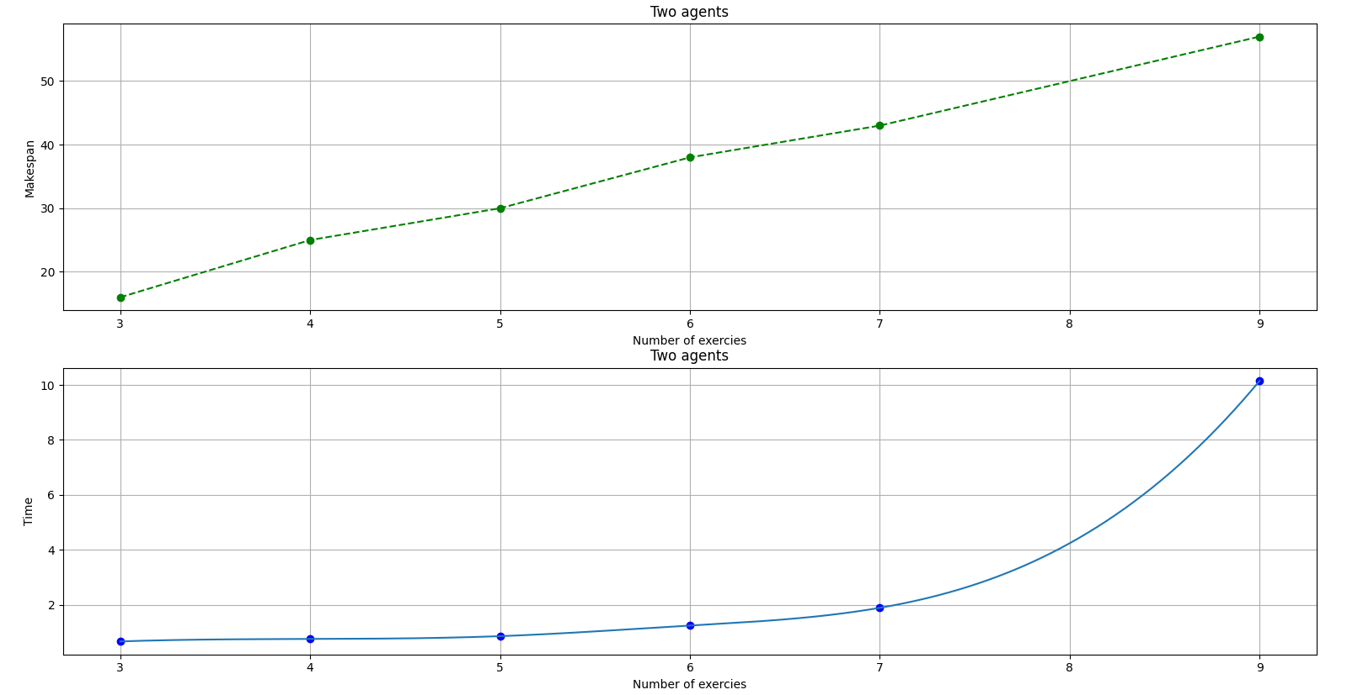

Slide 15
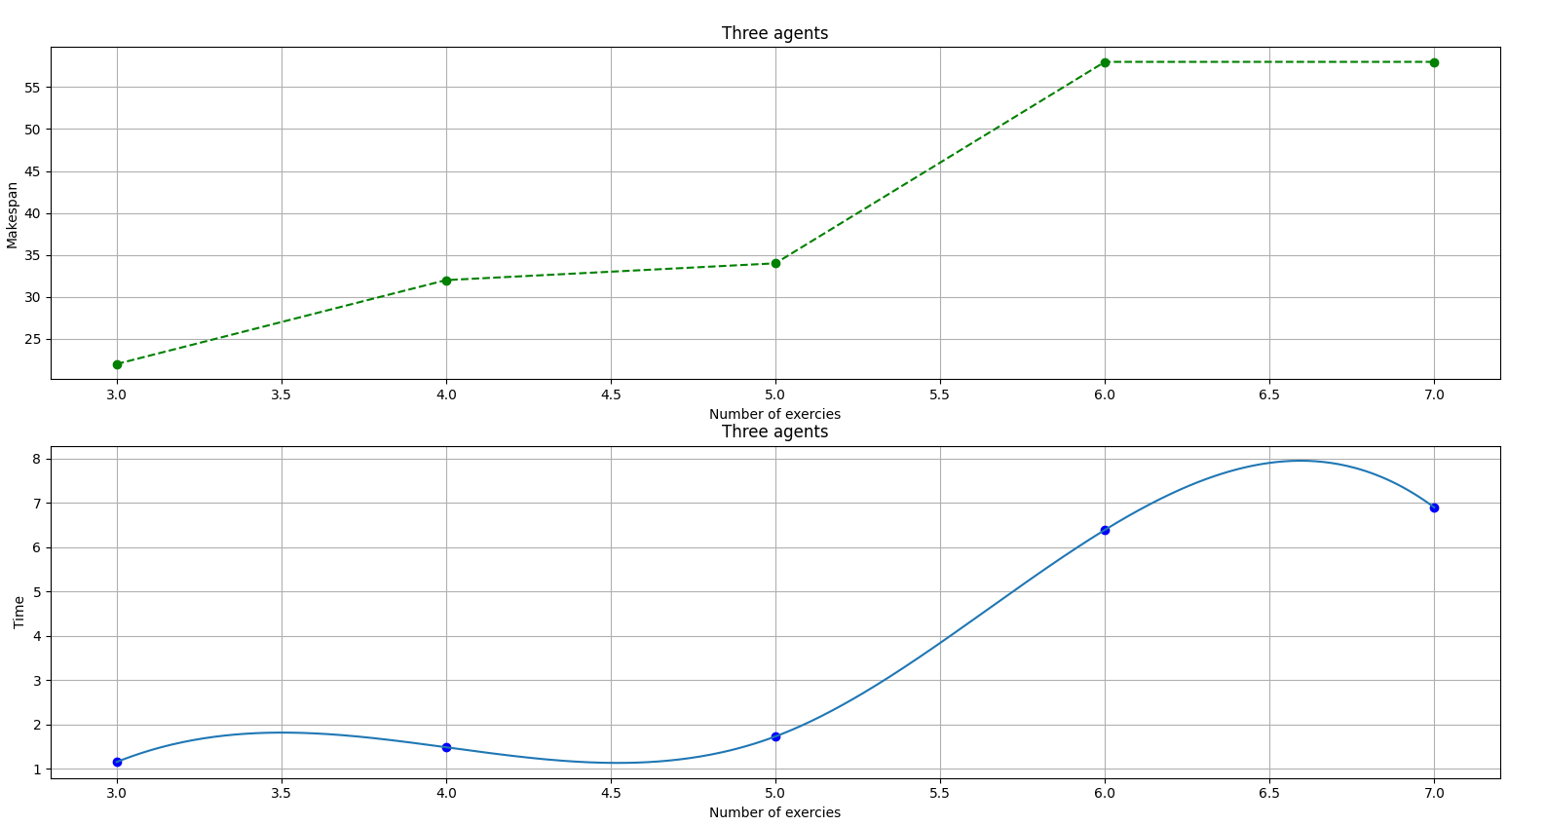

Slide 16
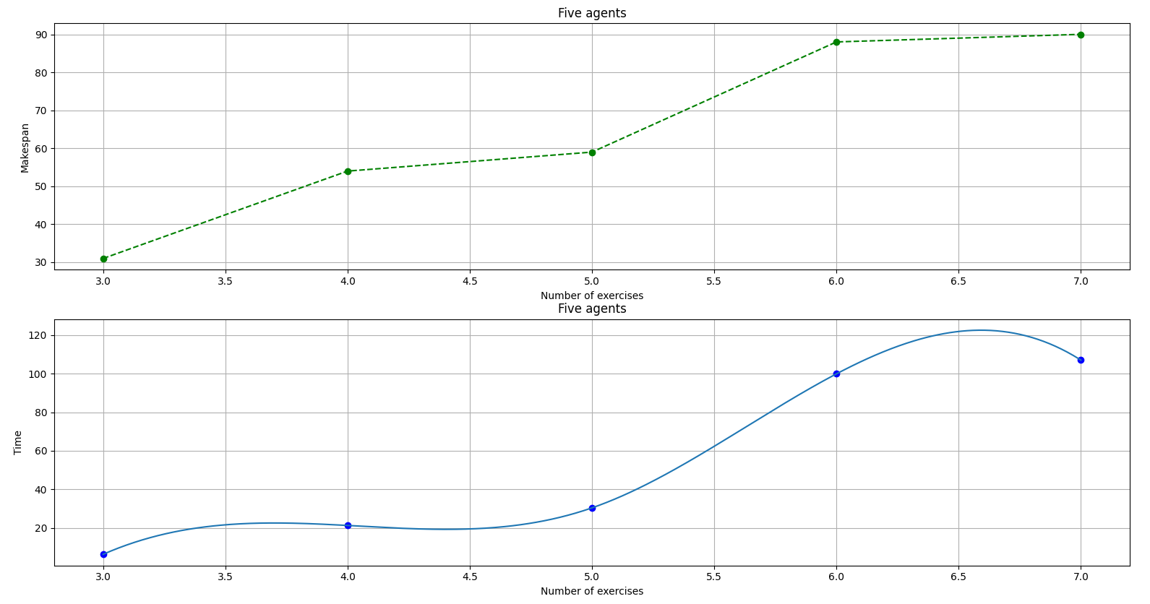

Slide 17
